Slide 1
Swept Frequency Capacitive Touch Sensing
A Mini-Project
Presentation on
Naman Kalkhuria (IEC2010065)
Prathak Rastogi (IEC2010093)
Prashant Mishra (IEC2010096)

Slide 2
Abstract
In our project, we are implementing the technique of Swept Frequency Capacitive Sensing.
We are going to use Arduino Uno Board as Micro-controller board and we are going to use Processing programming language for making a GUI for the module.

Slide 3
Motivation
Need of interaction
Most common type of interaction is touch.
To identify various configurations of touch.

Slide 4
Scope
For detecting the touch on a door knob.
For detecting configuration of fingers touching to each other.
For detecting touch in liquid.
For detecting the touch and configuration of touch on normal touch sensitive screens.

Slide 5
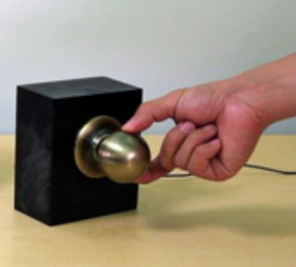
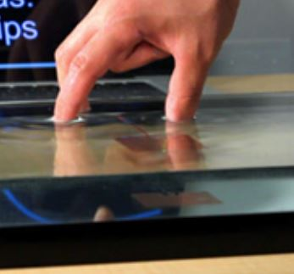
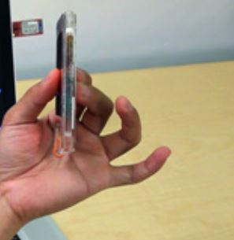

Various Applications

Slide 6
Introduction
Using Micro-controller in place of DSP in Swept Frequency Capacitive Sensing.
Multi-touch and touch configuration sensing.

Slide 7
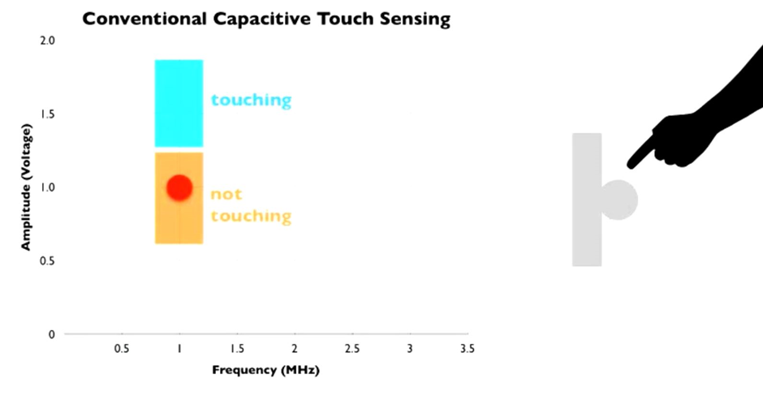
Conventional Touch

Slide 8
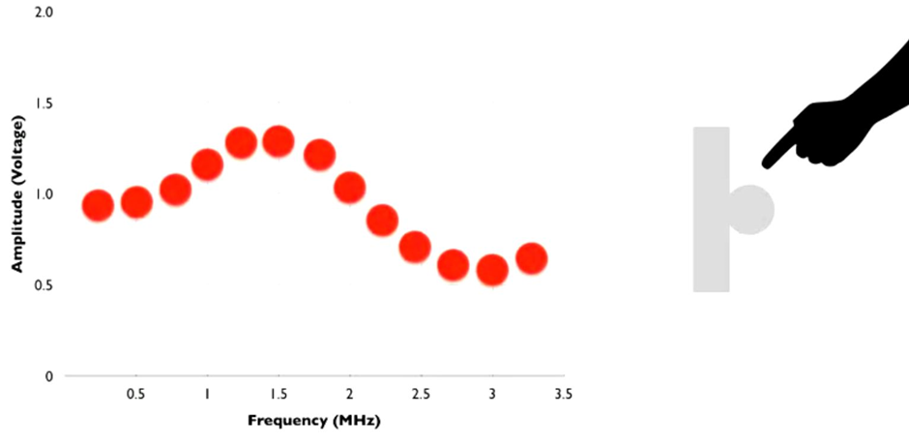
SFCS Touch

Slide 9
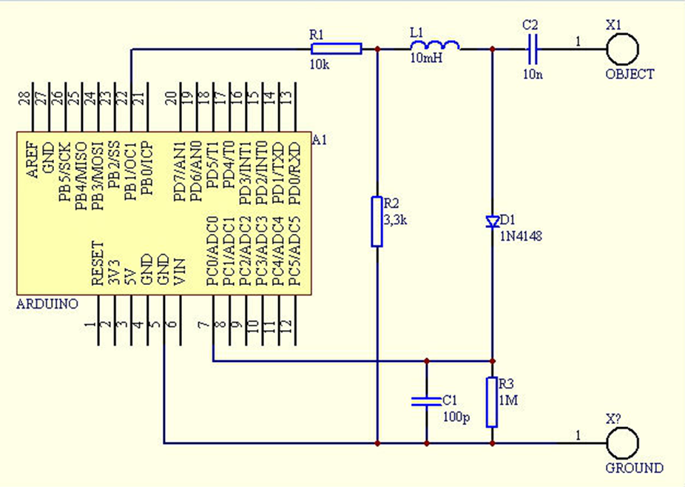
Circuit Diagram

Slide 10
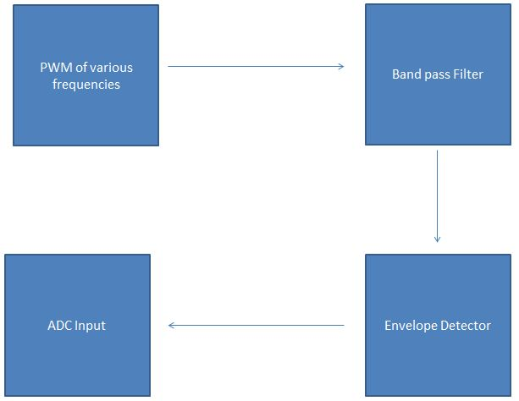
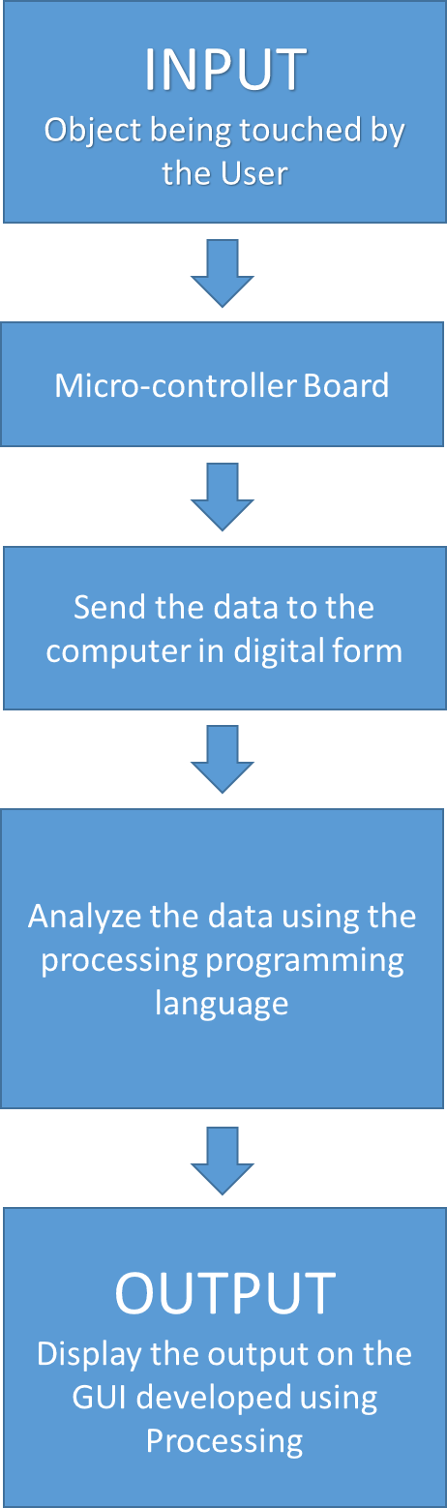
Block Diagram

Slide 11
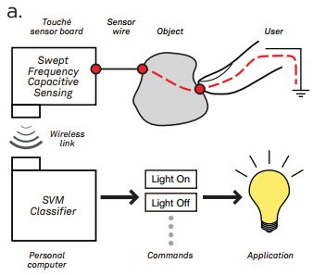
Sensing
Swept Frequency Capacitive Sensing
Here, we monitor the response to capacitive human touch over a range of frequencies.

Slide 12
Various Operating Ranges:
PWM output frequency range: 0 to 100 KHz
Envelope Detector Capacitor discharging 1/τ = 100Hz
ADC operating frequency = 200KHz
GUI update rate = 1Khz

Slide 13
Various Configurations we are studying on the coffee cup:
No Touch
One Finger Touch
Three Finger Pinch
Grab
Finger in Water

Slide 14

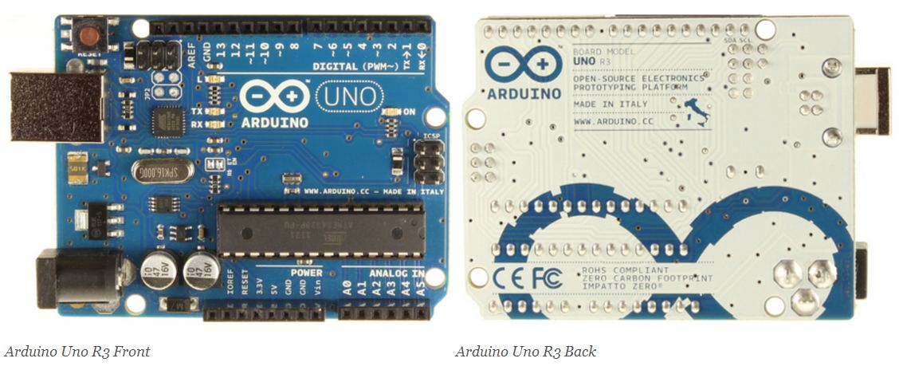
Micro-controller Board
Arduino Uno R3

Slide 15
Arduino Specs:
Microcontroller | ATmega328
Operating Voltage | 5V
Input Voltage (recommended) | 7-12V
Input Voltage (limits) | 6-20V
Digital I/O Pins | 14 (of which 6 provide PWM output)
Analog Input Pins | 6
DC Current per I/O Pin | 40 mA
DC Current for 3.3V Pin | 50 mA
Flash Memory | 32 KB (ATmega328) of which 0.5 KB used by boot loader
SRAM | 2 KB (ATmega328)
EEPROM | 1 KB (ATmega328)
Clock Speed | 16 MHz

Slide 16
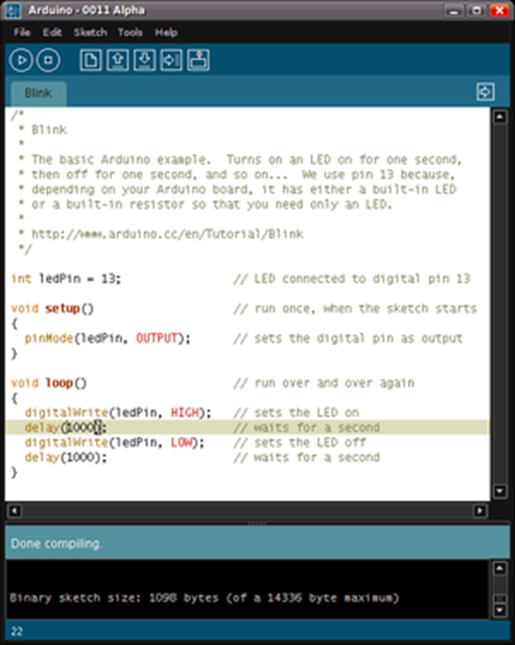
Arduino IDE

Slide 17
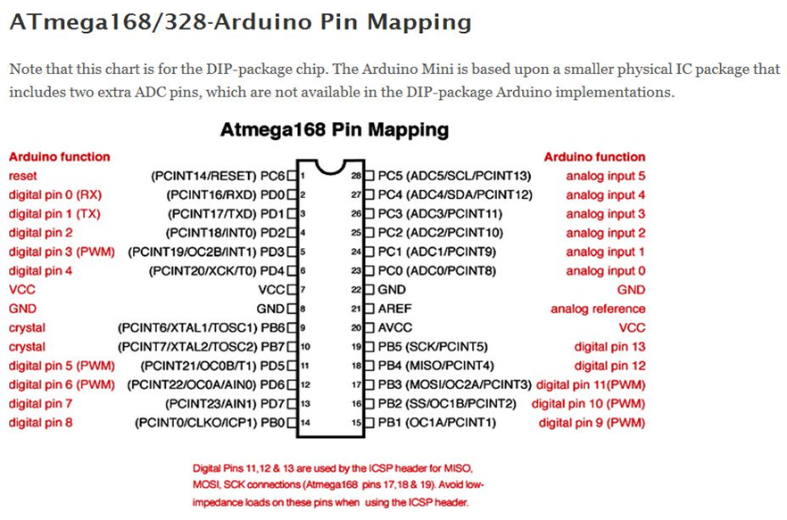

Slide 18

Processing Programming Language
Processing is for writing software to make images, animations, and interactions.
Processing includes a sketchbook, a minimal alternative to an integrated development environment (IDE) for organizing projects.

Slide 19
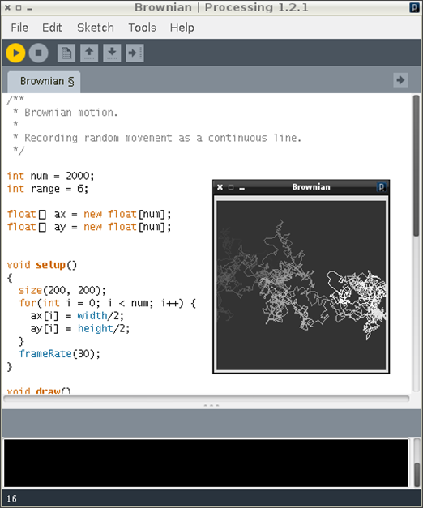
Processing IDE

Slide 20
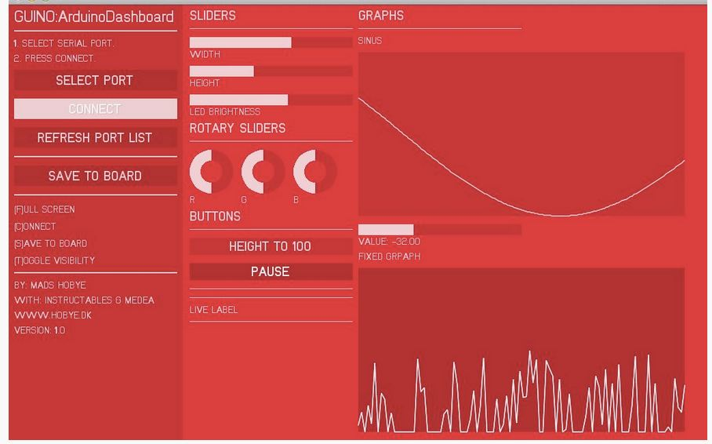
GUINO
Custom design your interface from the Arduino board
Visualize and manipulate real time data
Save the parameters in the boards memory

Slide 21
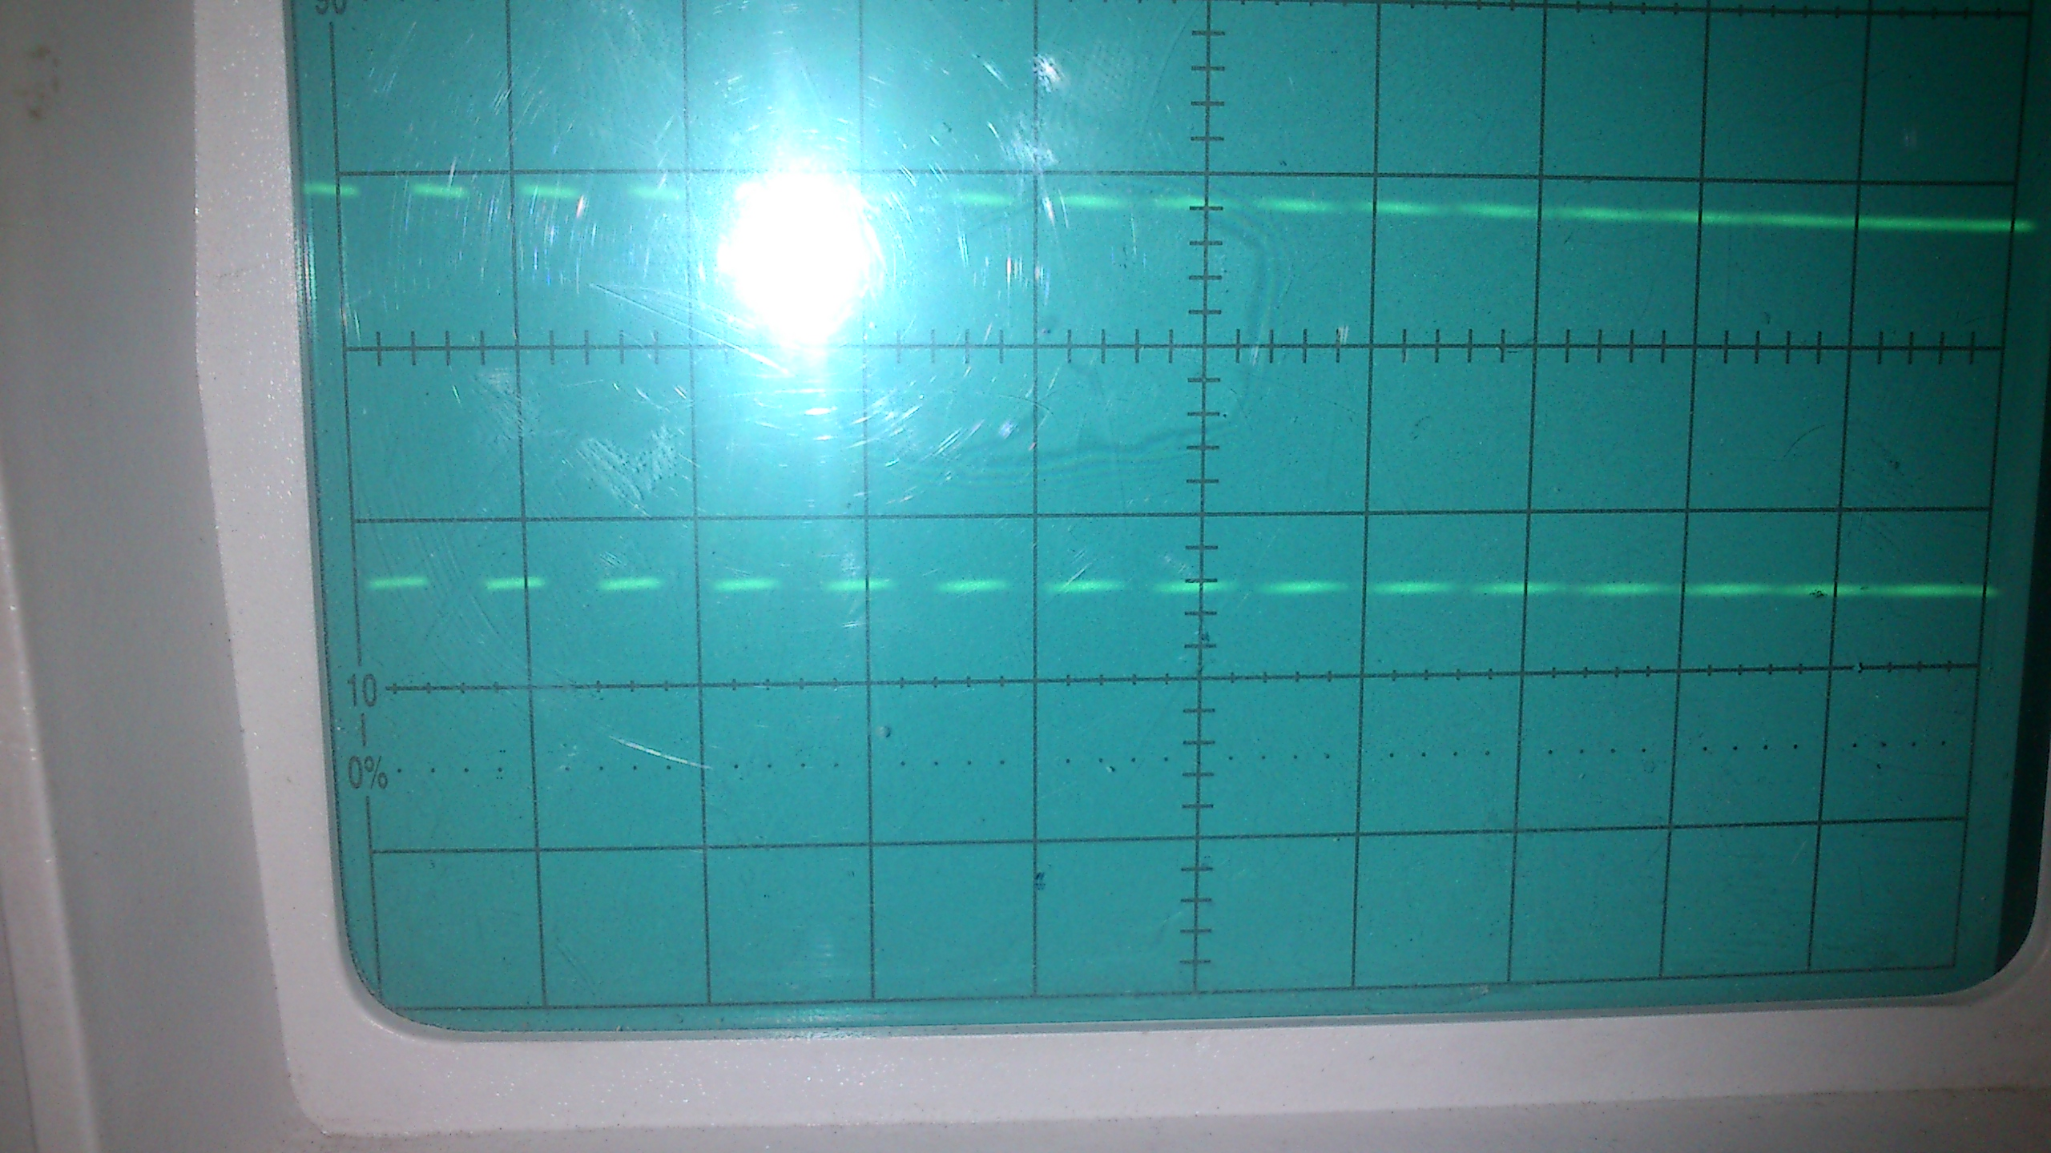
Input from PWM pin:

Slide 22
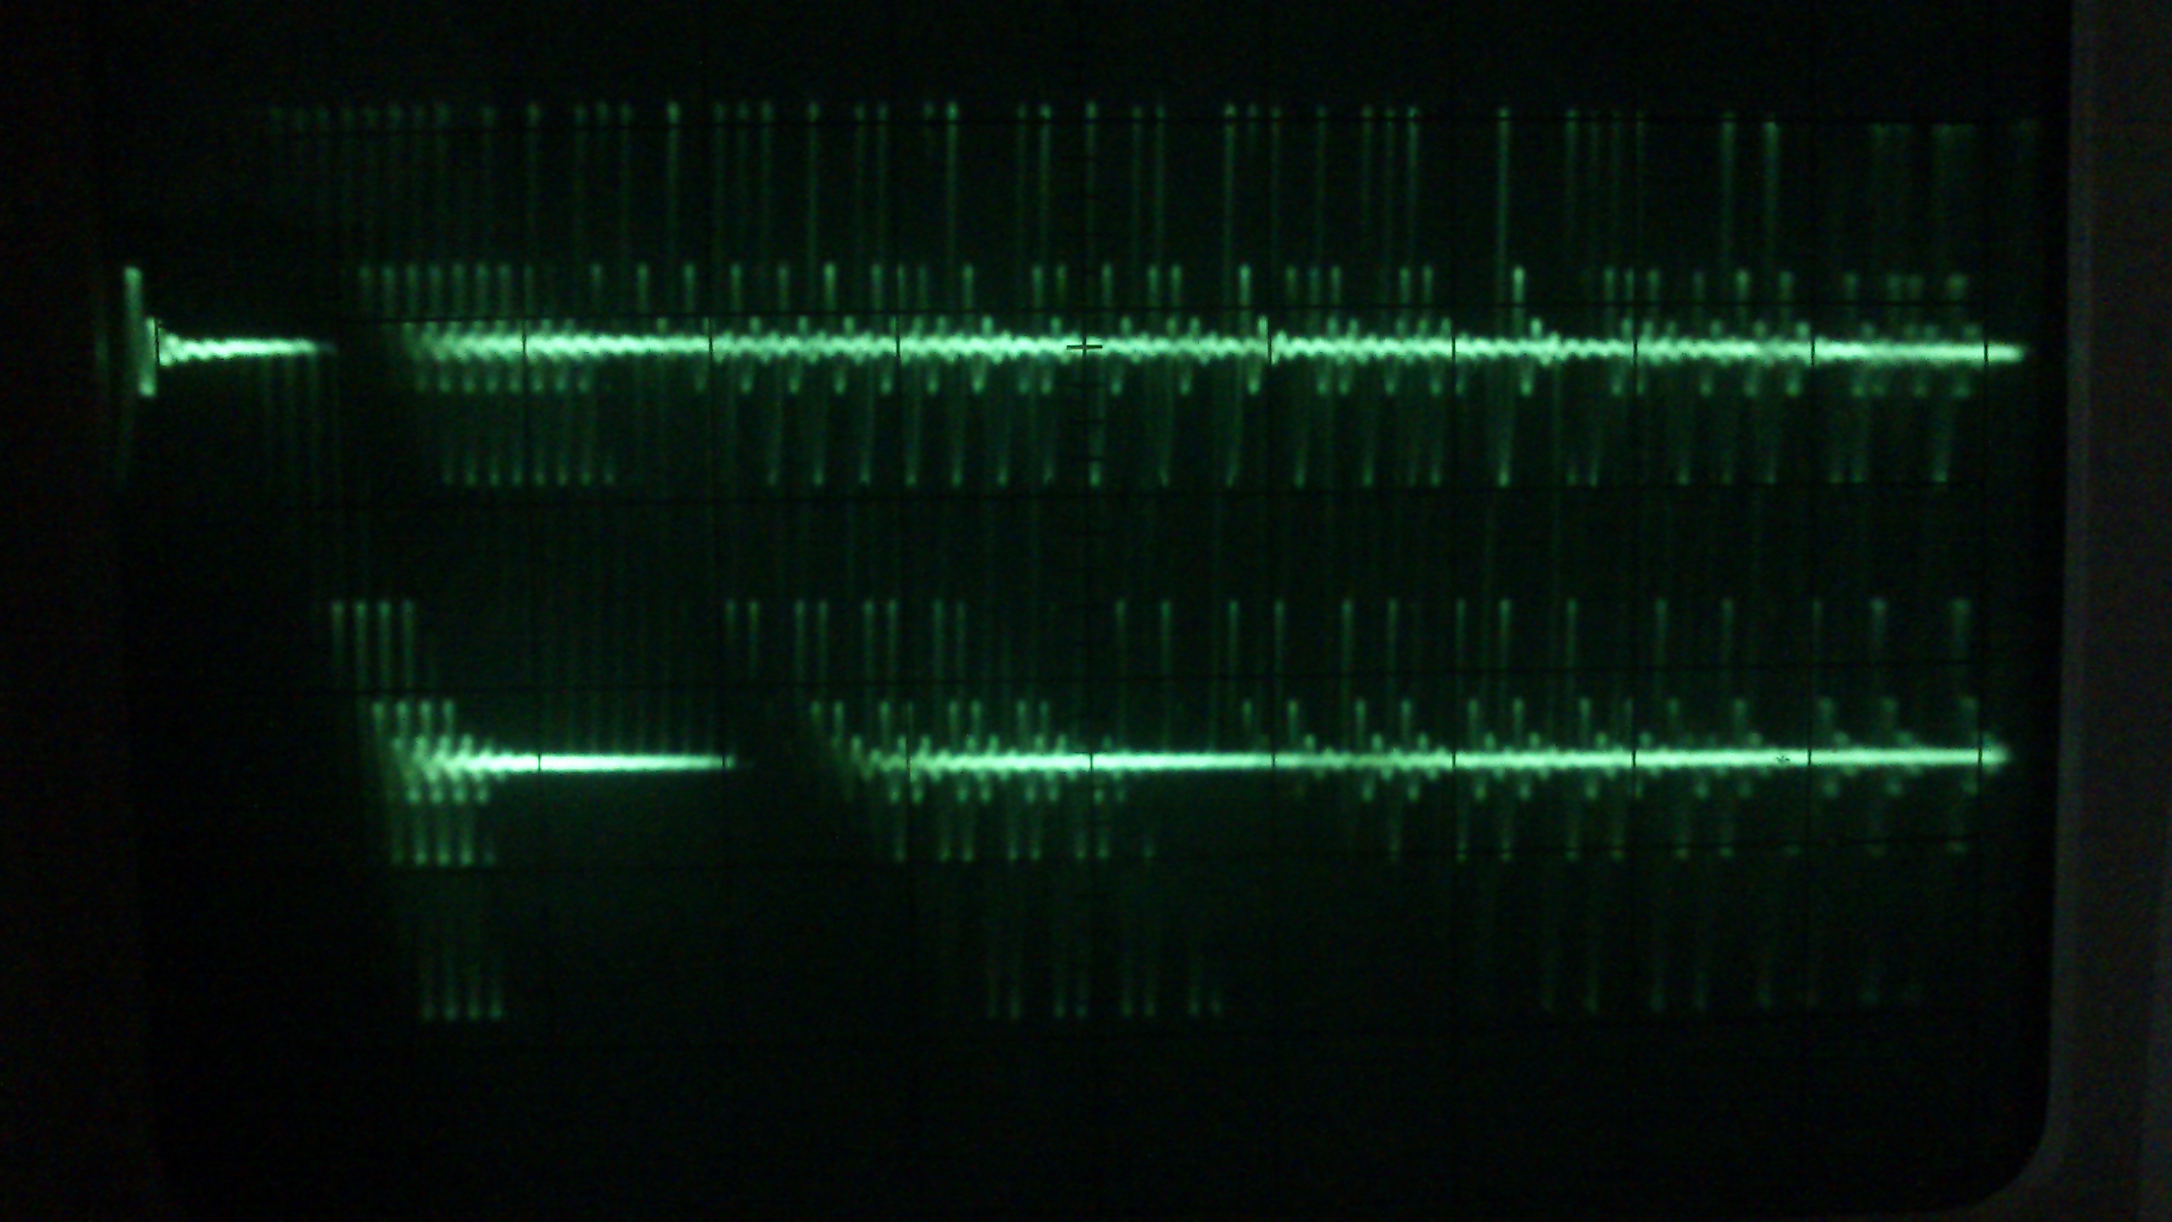
Distorted PWM

Slide 23
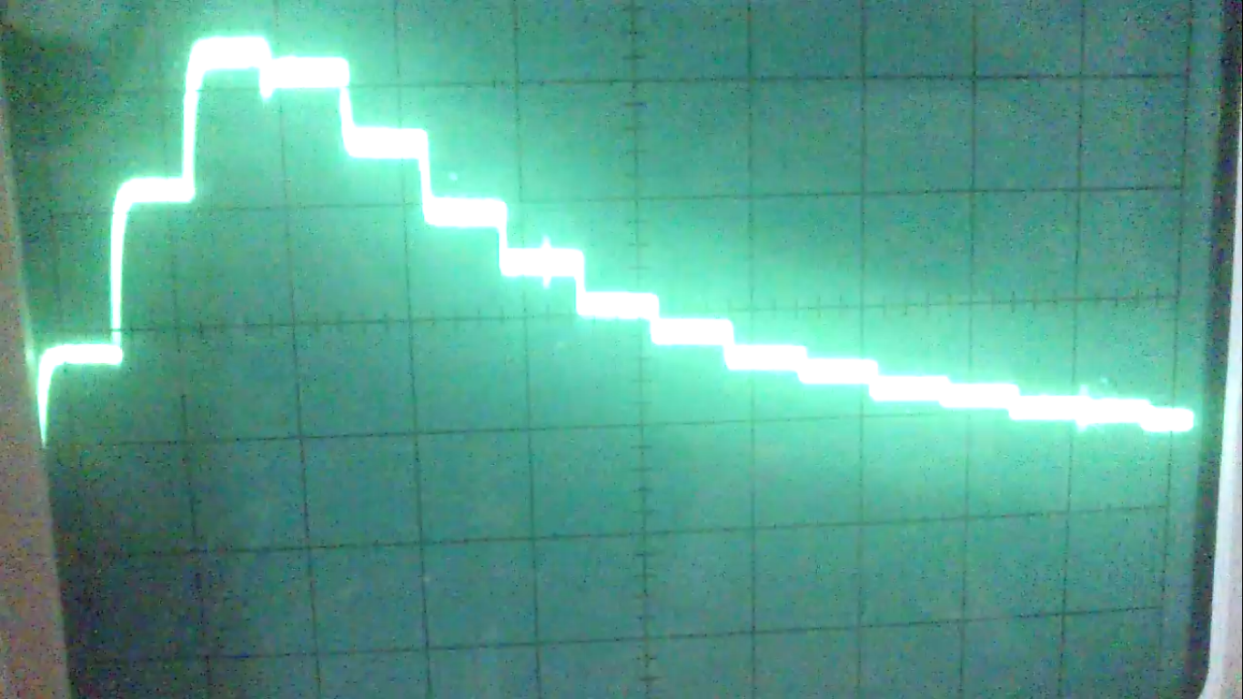
OUTPUT after Envelope Detector:

Slide 25
THANK YOU

